Slide 1
Negotiating ESI Protocols for the Use of Generative AI in e-Discovery
Training material only.

Slide 2
5 minutes Introductions
30 minutes Scripted Negotiation
25 minutes Discussion
15 minutes Workshop
10 minutes Group Sharing
5 minutes Close and Next Actions
Agenda

Slide 3

Notes:
Buzz Nectar Syndicate (BNS) is a company that produces honey for retail sale throughout the United States.

Slide 4


Notes:
Last year, in order to boost profits, they decided to infuse their honey with CBD and go to market with Bee Serene Honey.

Slide 5


Notes:
BNS initially sourced its CBD from a reputable manufacturer, but the supplier costs started cutting into their profits. The Head of Sales directed the person in charge of sourcing, Matt Gorman, to find a cheaper alternative or they would both be out of a job.

Slide 6



Notes:
Mr. Gorman shopped around and found that he could get THC much cheaper from High Hopes Herb Co. Mr. Gorman and the Product Marketing Manager, Sarah White, discussed the change and decided not to change the labels on the honey bottles or any of the promotional materials. They were concerned that people wouldn’t purchase the honey if they knew it had THC in it.

Slide 7
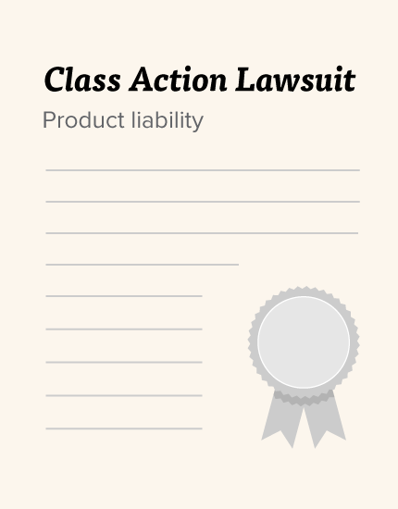



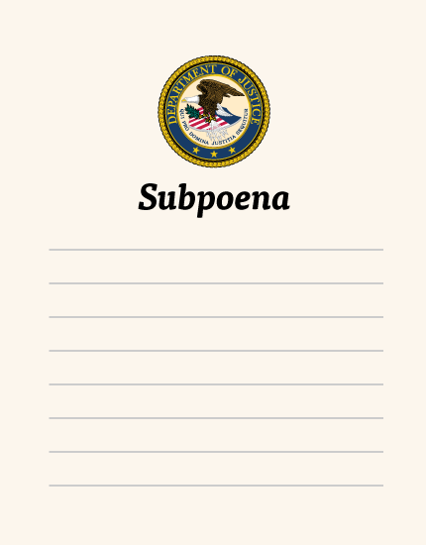
Notes:
As you can imagine, shortly after the change, people started reporting adverse reactions to the honey, including hallucinations. Some people even failed their drug tests at work and got fired. [CLICK]
Fast forward a year later and we now have a class action suit against BNS for product liability claims. And the DOJ has started their own investigation to determine whether any criminal laws have been broken, and have issued a subpoena for documents.

Slide 8
Parties may use generative AI to assist in fulfilling their discovery obligations. Neither party may challenge the sufficiency of the production solely on the basis that generative AI was used in the process.
Provision at Issue

Slide 9
aiR for Review

Slide 10
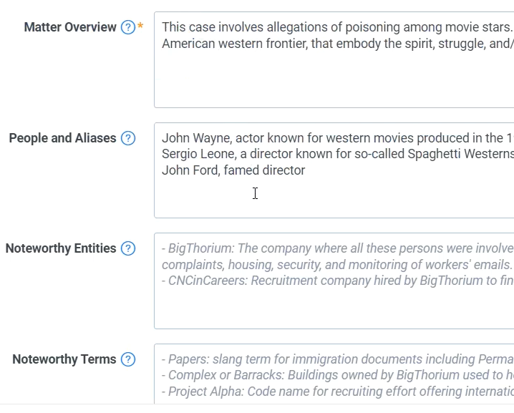
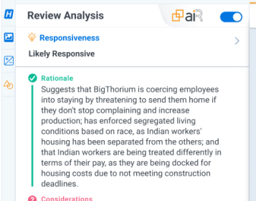
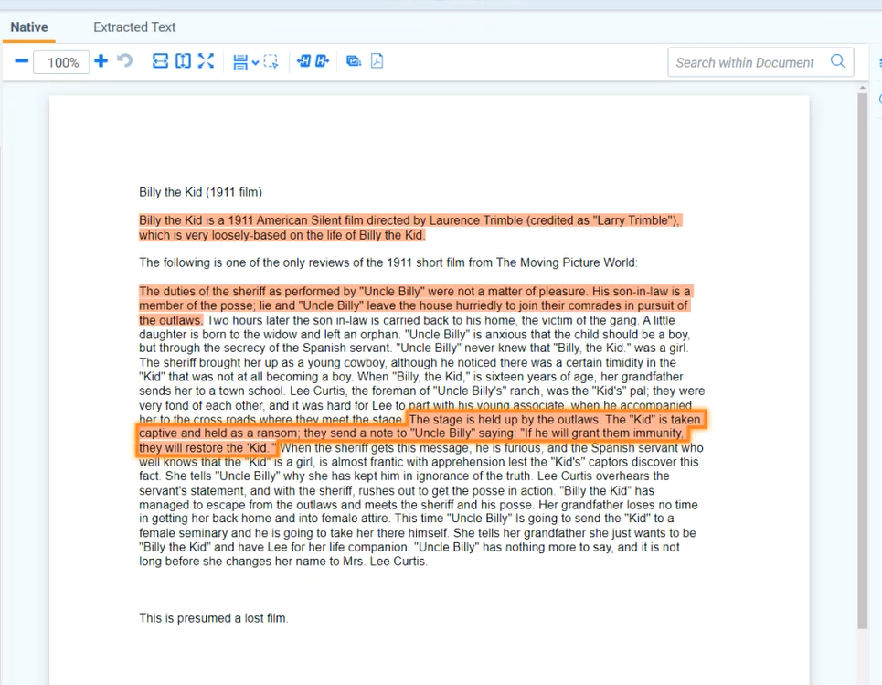

Lawyer / SME Describes the Matter
aiR Analyses Documents Using Inputs
Lawyer / SME Reviews aiR’s Analysis
Notes:
And at the highest level, this is the xperience
First, the lawyer describes the matter – providing information about the matter, defines what makes a document relevant
Then, aiR for Review uses that input, that prompt criteria, to make predictions backed by detailed rationales and citations
Last, attorneys review that analysis
So let’s now see the product that is currently out to a limited set of US, UK, and Australia customers

Slide 11
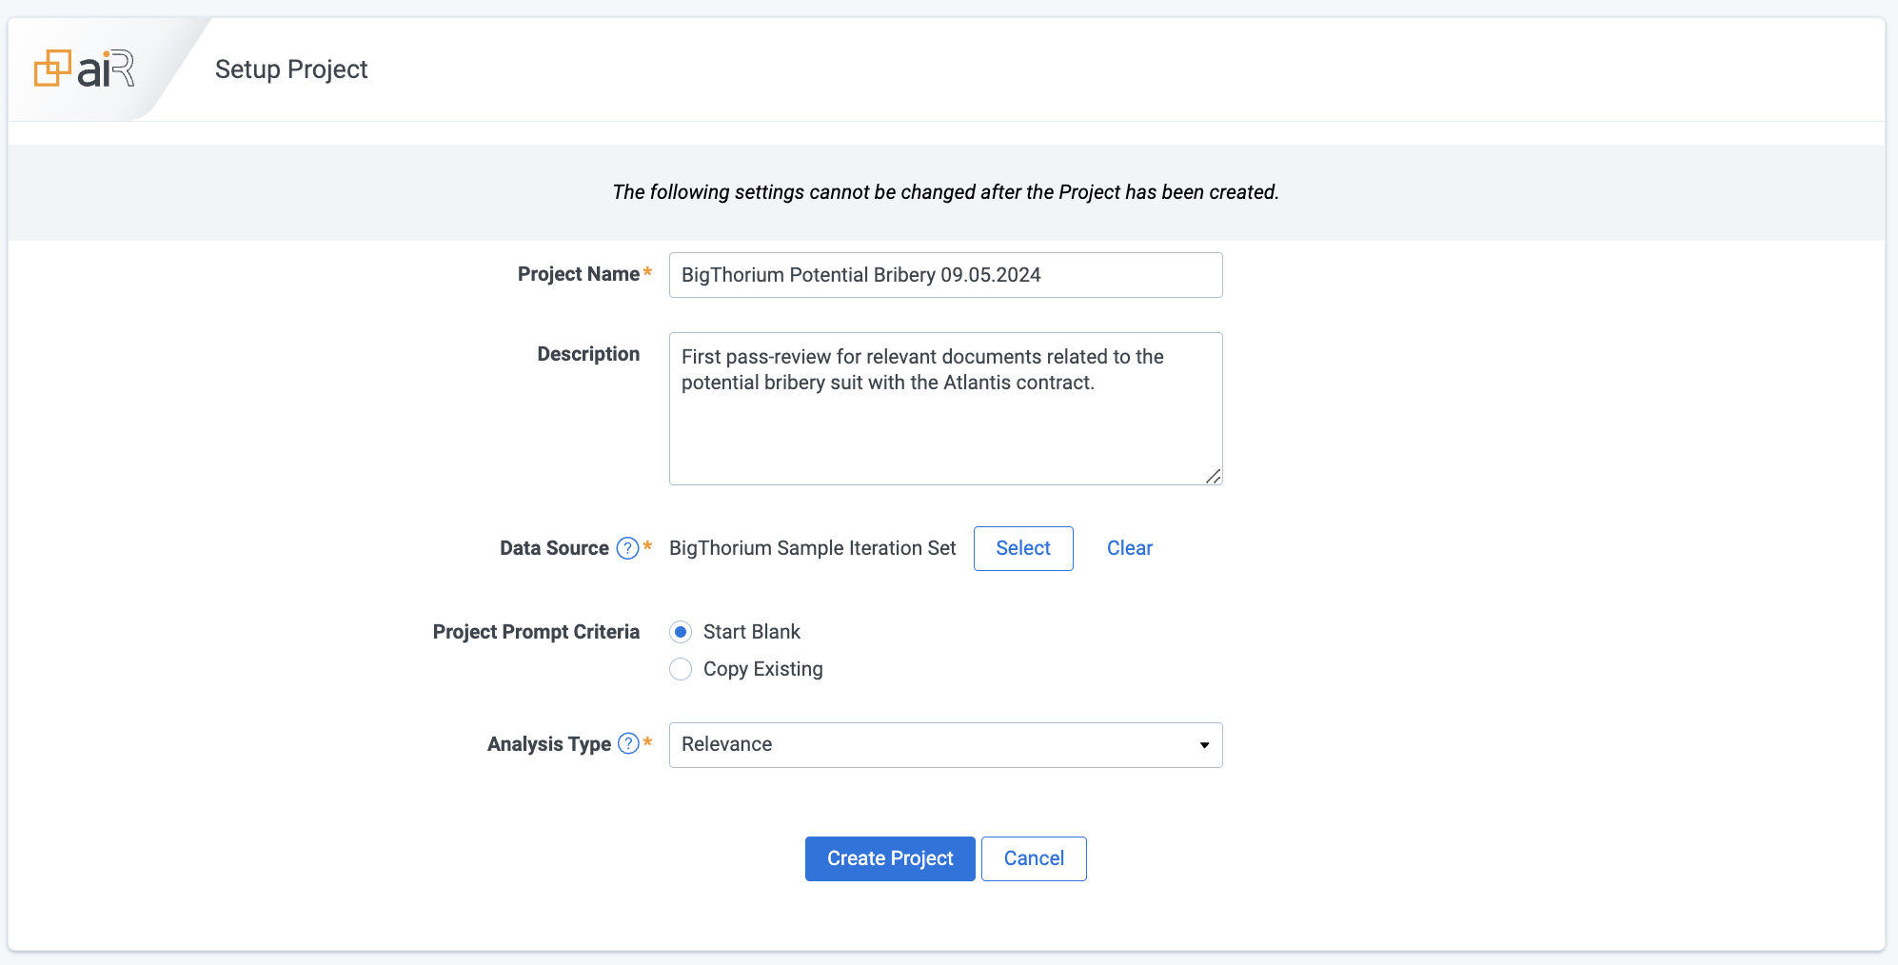
Setting up your aiR for Review Project
The dataset used here is AI-synthesized and, although inspired by real-life events, its details, contents and the events that it depicts are fictional. Any similarities between real people or events is entirely coincidental and not intentional.
Notes:
You’ll start by navigating to a workspace and c

Slide 12
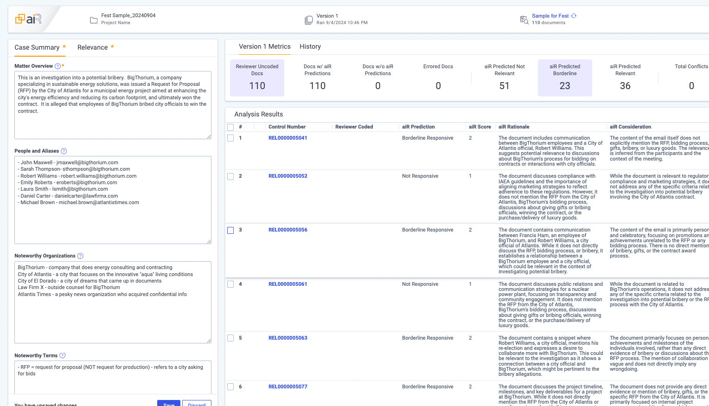
Creating your first prompt (2min)

Slide 13
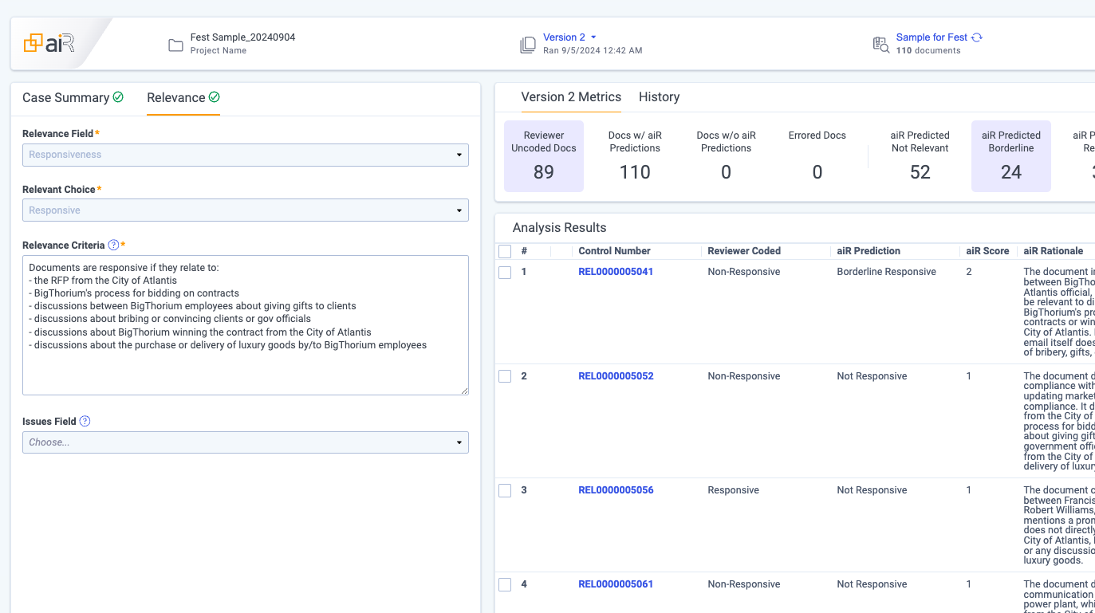

Slide 14
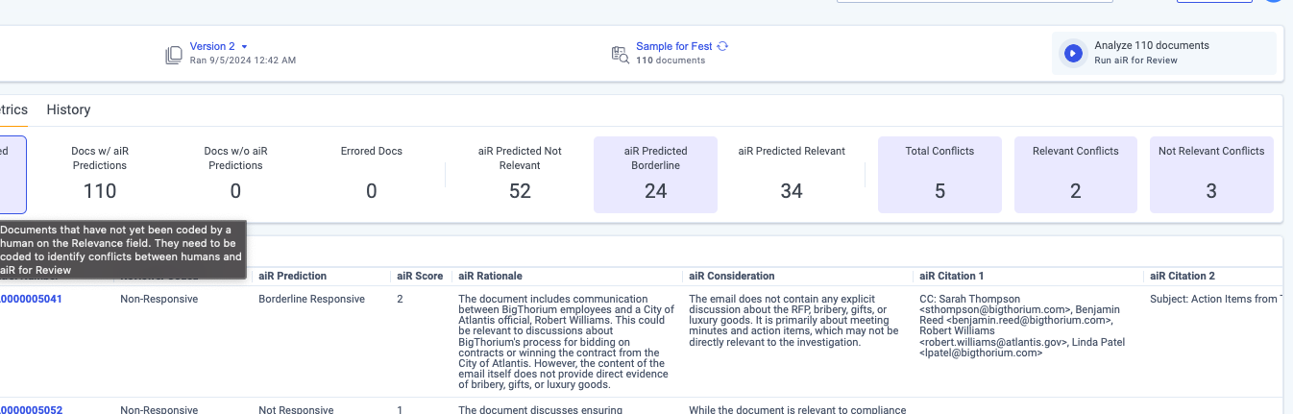
conflicts

Slide 15
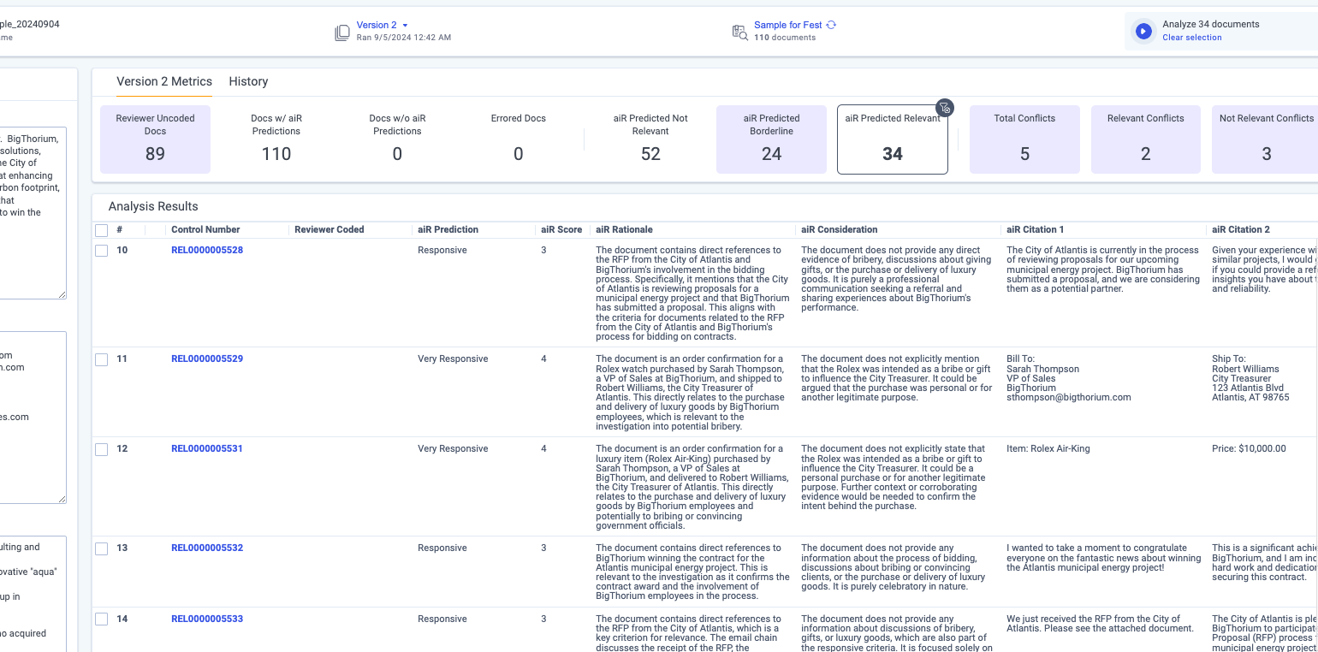
Results in the list

Slide 16
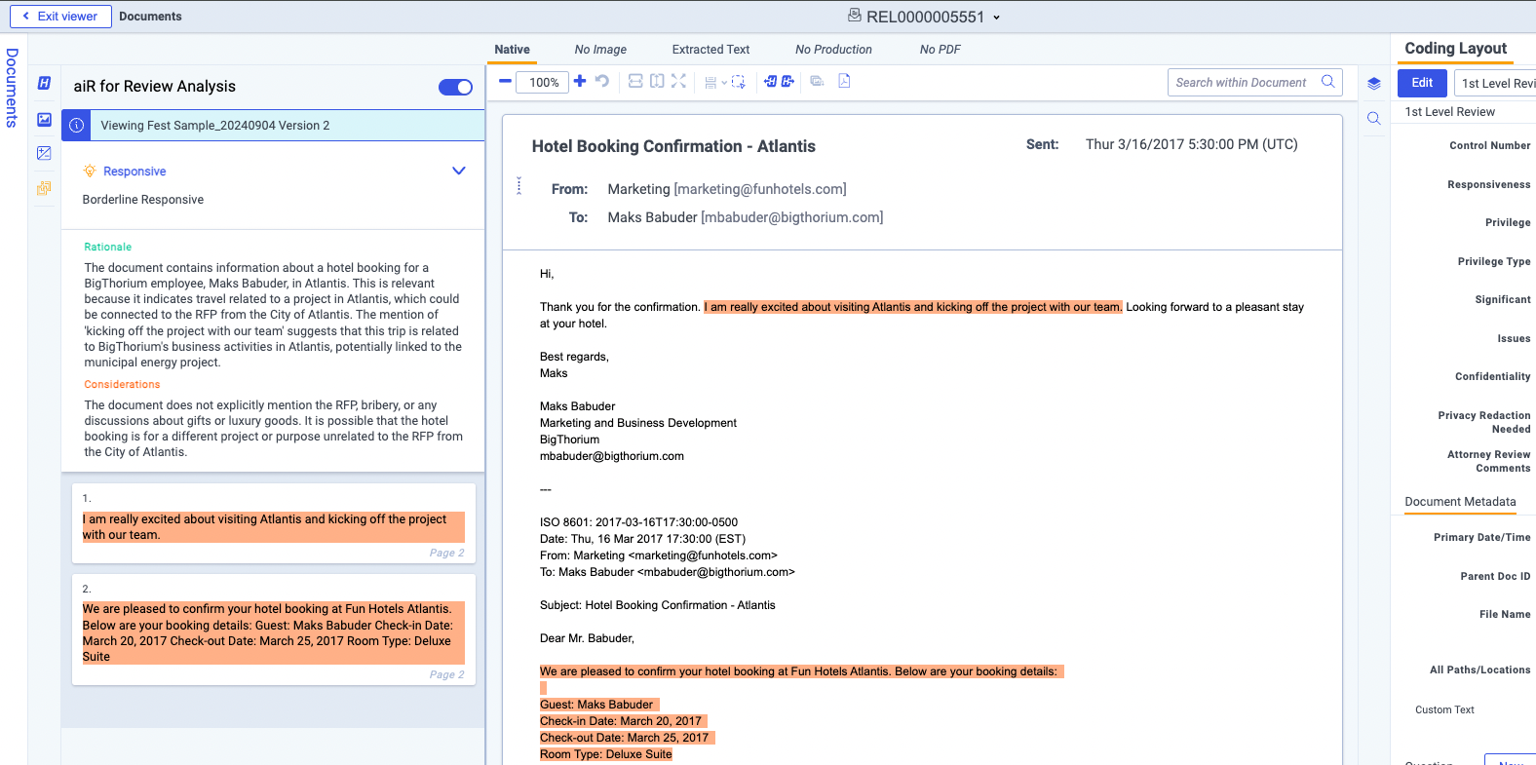
Jumping into the document viewer and seeing highlights and stuff (1min)

Slide 17
Back to Negotiations…

Slide 18
Validation Workflow

Slide 19
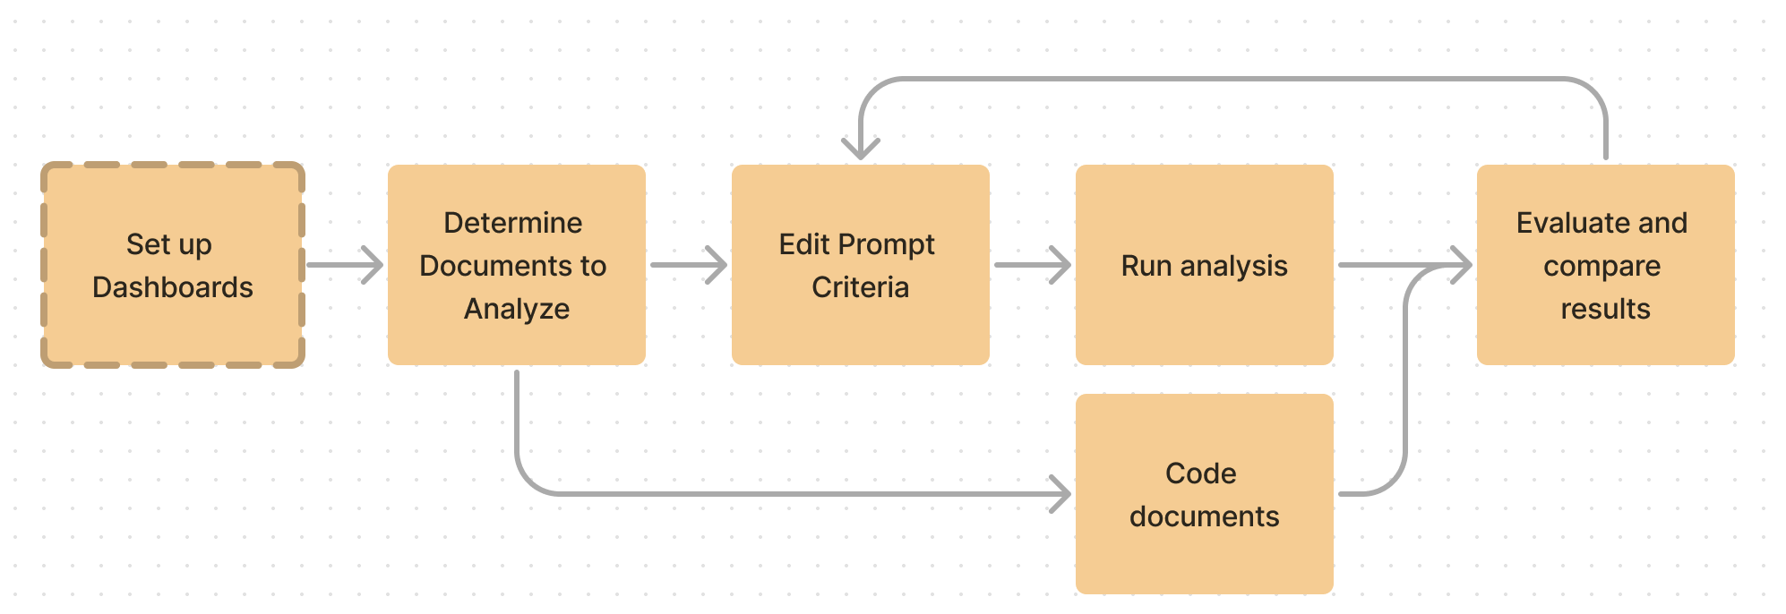
First Stage: Develop Prompt Criteria
Level set or "train" aiR for Review on your case and review instructions via Prompt Criteria
It is not a statistical evaluation, but leads to making additions and clarifications to the
Prompt Criteria
Subject Matter Expert
An SME is expected to iteratively develop Prompt Criteria by evaluating aiR results.
Small sample of documents
Representative of different aspects of what you will be reviewing, including relevant and not relevant documents. Sets of 50 documents can be run in Fast Track.
Evaluate analysis disagreements
Comparing predictions vs. SME coding decisions, in particular false positives and negatives, can inform necessary Prompt Criteria updates.

Slide 20
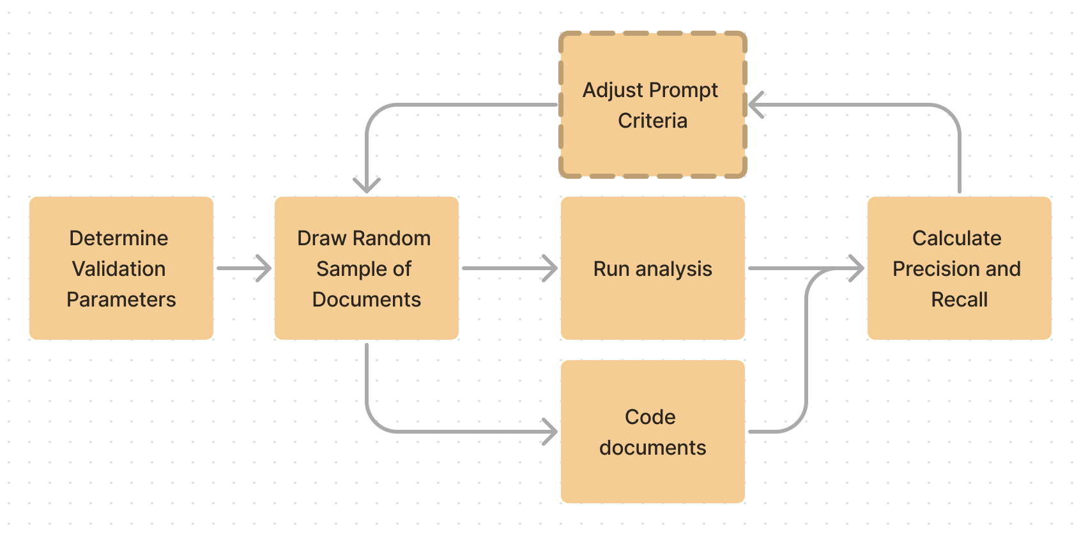
Second Stage: Validate
Bring more statistical rigor to evaluating and finalizing the Prompt Criteria
This step is optional but can bring more confidence to running aiR on a large set of documents
Unbiased coding
Reviewers are not exposed to aiR predictions
Statistical samples
Larger sets of random documents sized to provide acceptable confidence and margin
of error.
Calculate accuracy
Comparing predictions vs. coding decisions using precision and recall to find an acceptable level of performance.

Slide 21
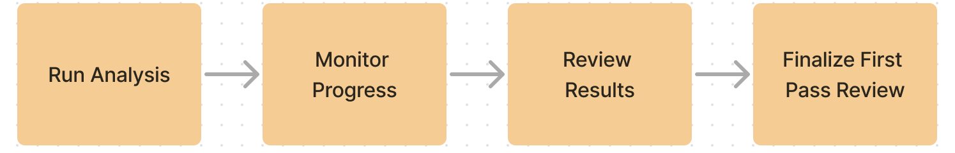
Third Stage: Run
Run aiR for Review at scale to do substantial review
No additional review required by reviewers but analyzed documents can be further reviewed during subsequent stages of your review process.
Queues and streaming
Analyses are queued and can run in jobs of 50,000 documents at a time. Results are streamed back in small batches and can be used before full job completes.
Monitoring and troubleshooting
A jobs page can be used to monitor the status of different jobs. Some documents that are errored can be retried.
Validate your completed review
Measure the overall effectiveness of your review by calculating elusion rate, recall rate, and error rates.

Slide 22
Back to Negotiations…

Slide 23
Security

Slide 24
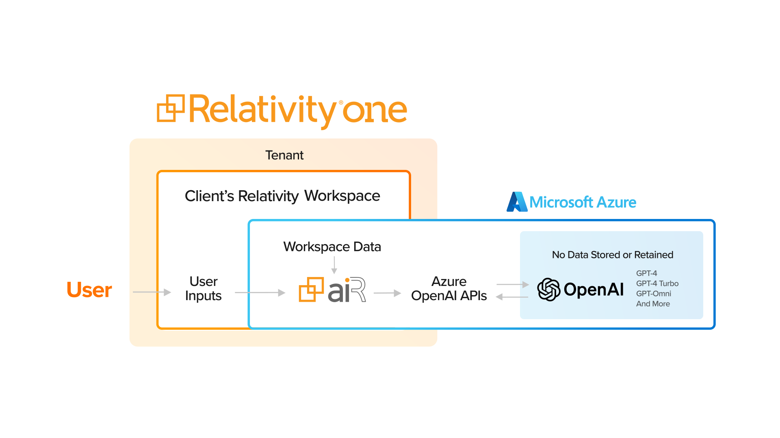
Notes:
First, we carefully reviewed and integrated Azure OpenAI services to ensure we upheld RelativityOne’s security and privacy obligations. And this reflects the solution of our entire aiR suite.
Four things to point out:
As you are using aiR, your document text, the prompt criteria, the predictions all remains safe within RelativityOne.
Second, the data is never retained or used for model training by us nor by Microsoft
Third, our integration will provide you access the very latest OpenAI models …

Slide 25
Back to Negotiations…

Slide 26
Discussion

Slide 27
Workshop

